Slide 1

Hackathon#3
January 11th, 2022

Slide 2
Fabien Guegan

Slide 3
1. Problem description

Slide 4
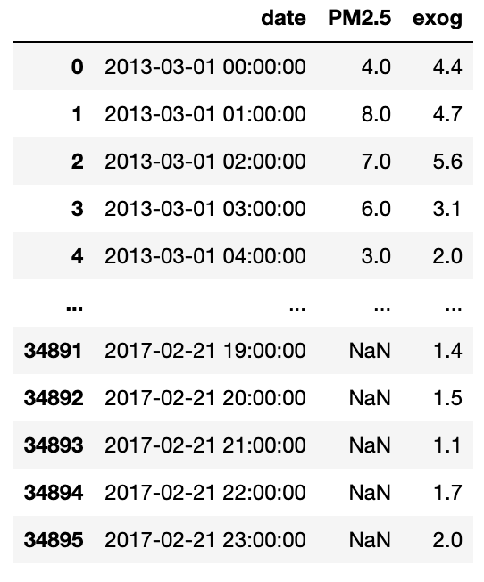
Problem description
PM2.5 are particulate matter (PM) that have a diameter less than 2.5 micrometers. These are some of the most dangerous pollutants and increase the risk of getting diseases like respiratory infections, lung cancer, and heart disease. Accurate forecasting of these pollutants with appropriate lead time can help implement more effective policies in cities with high levels of pollution.
Time series data :
PM2.5 pollution measure every hour
Exogenous variable = wind speed forecast
Objective:
to forecast PM2.5 pollution levels for the next seven days

Slide 5
2. Workflow

Slide 6
2.2 Data preparation

Slide 7
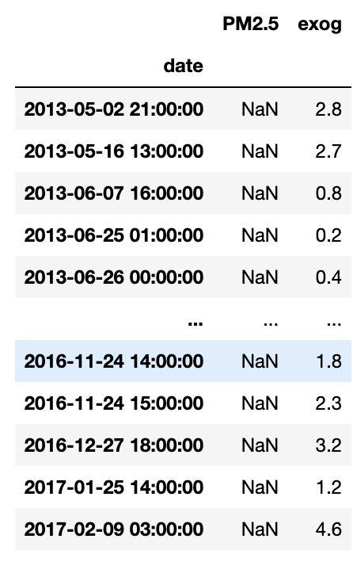
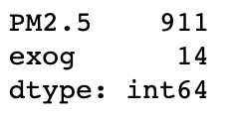
Data preparation
To convert Date column to Datetime
To set the Date column (Datetime) as index
To fill the missing values
df.isnull( ).sum( )

Slide 8
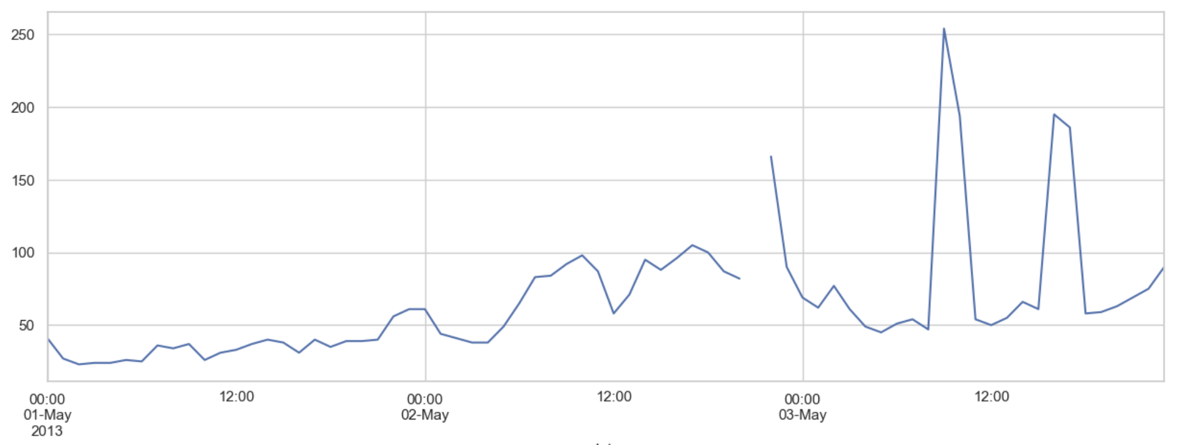
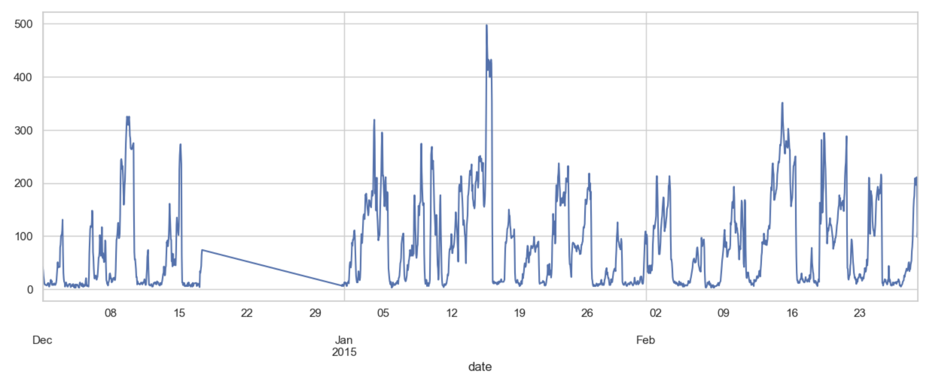
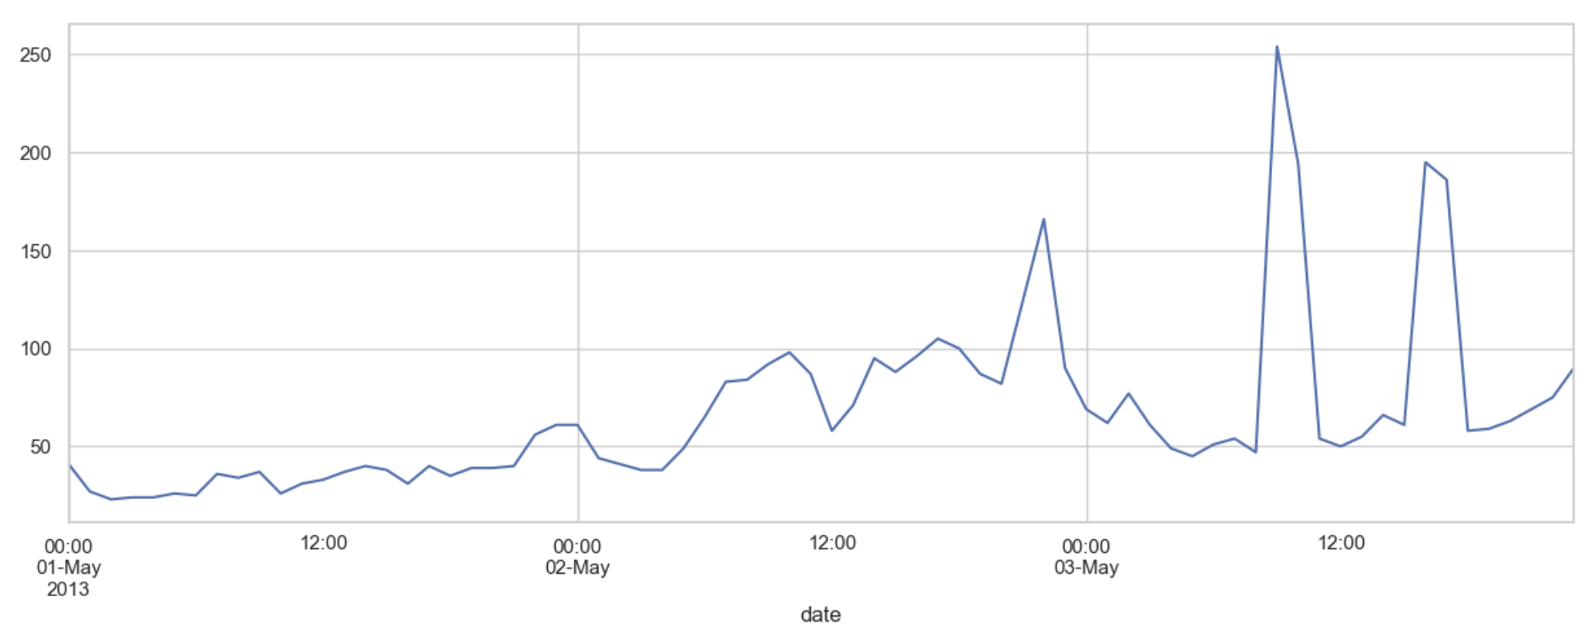
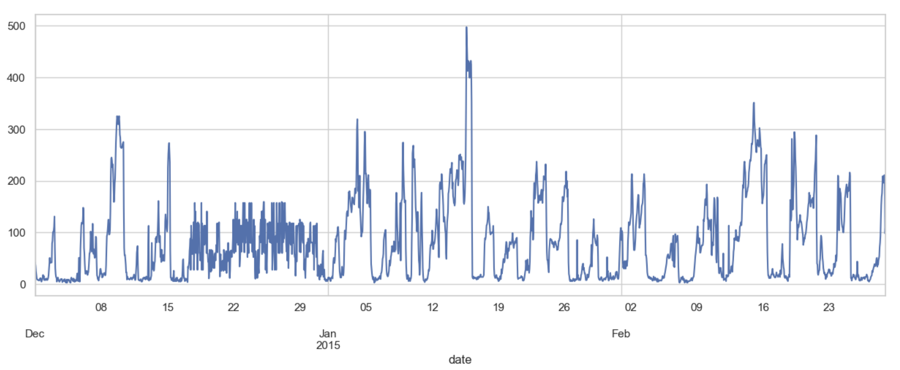
Data preparation
df. interpolate( )
df. interpolate( )
KNNImputer()

Slide 9
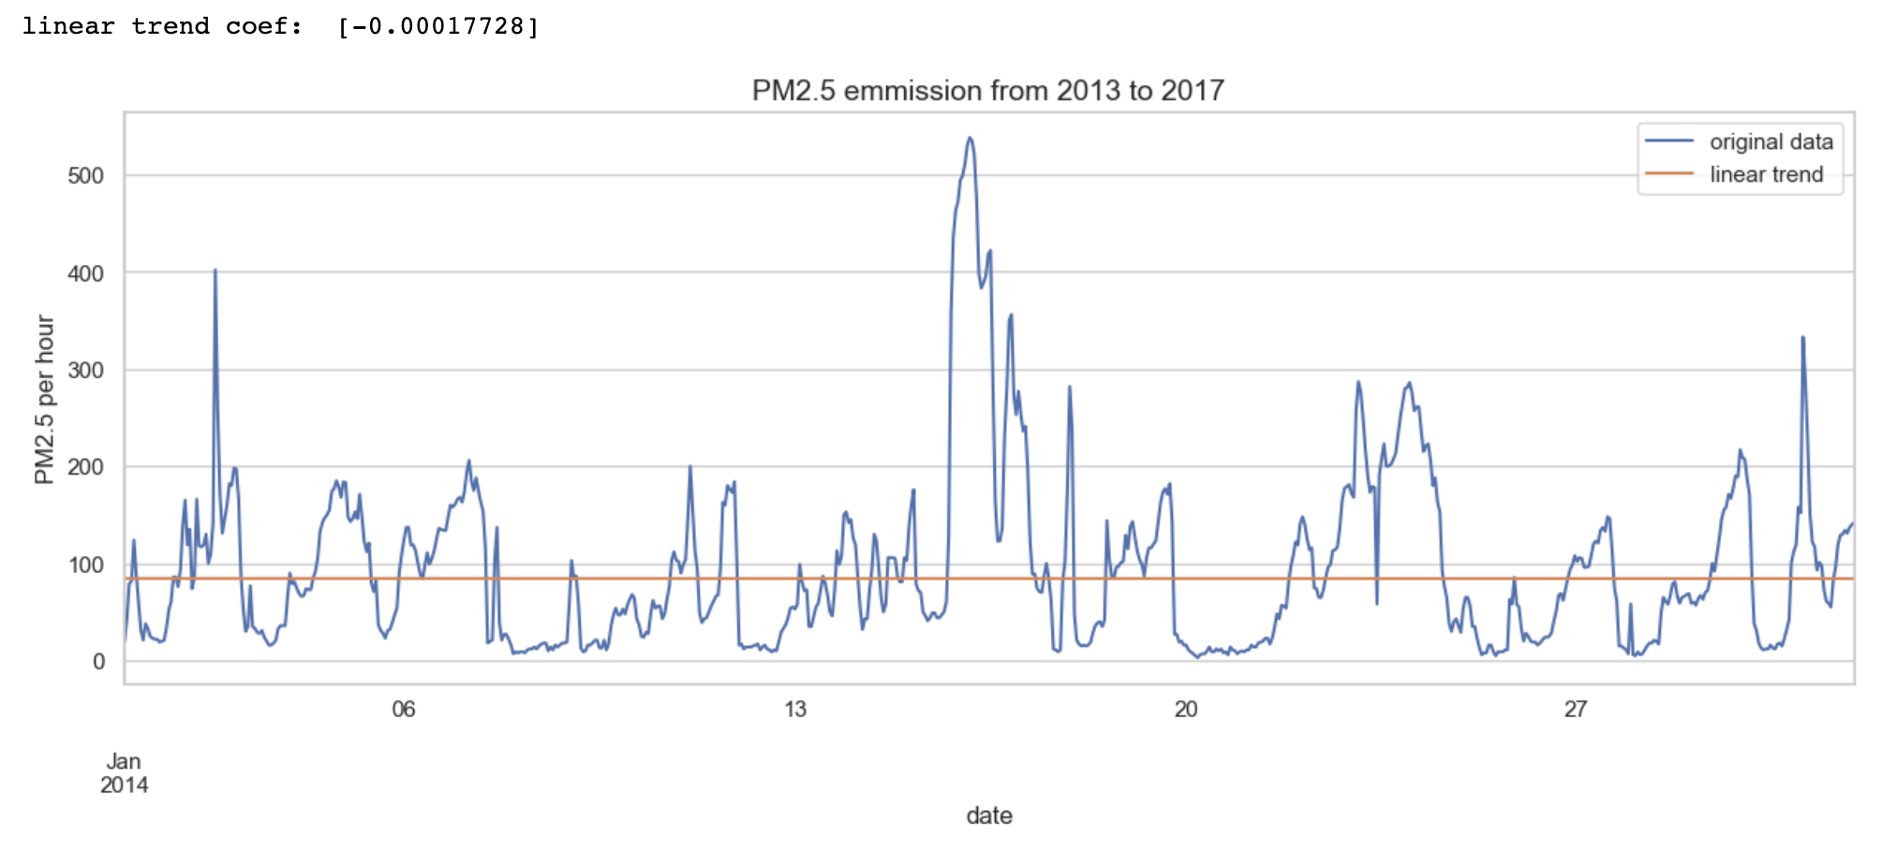
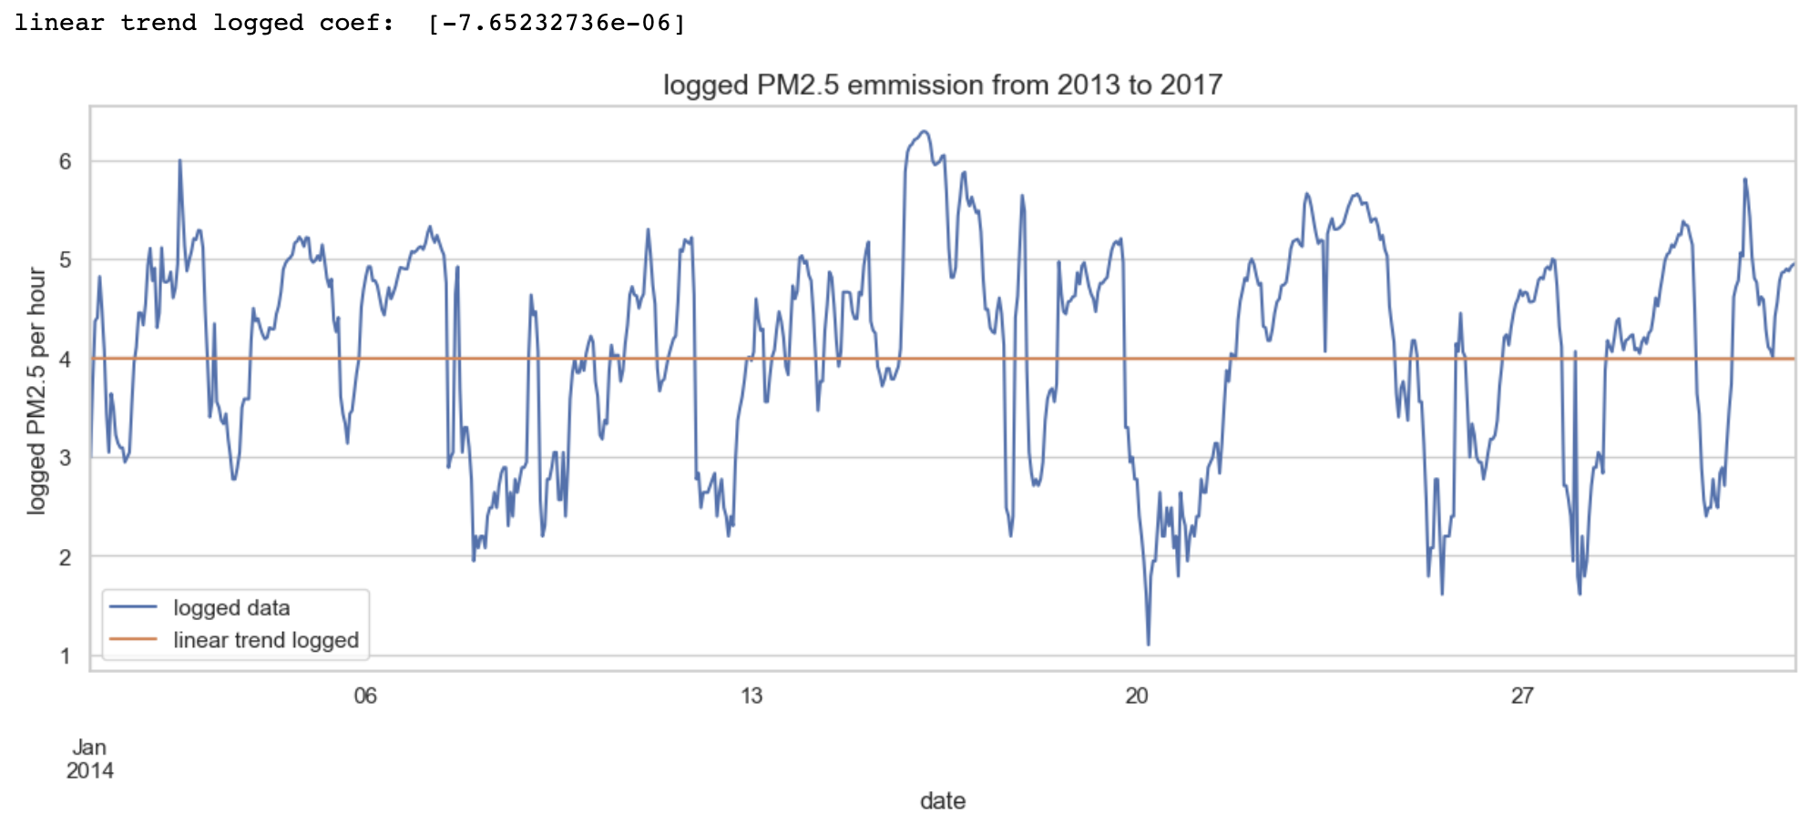
EDA - Trend
Original Dataset
Trend = -0.00017
To reduce the trend
Log transformed
Trend = -7.65^-06

Slide 10
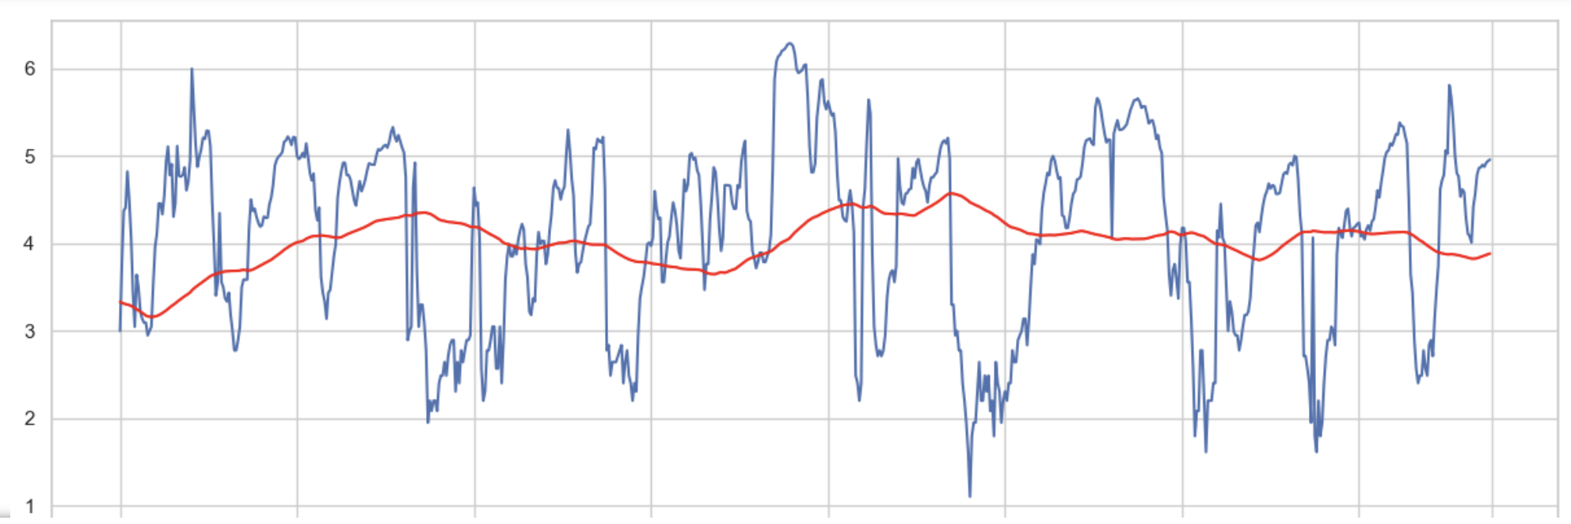
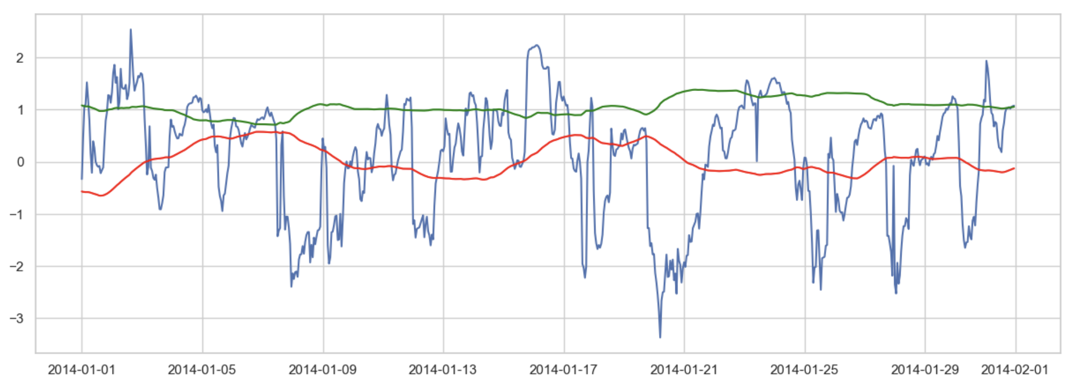
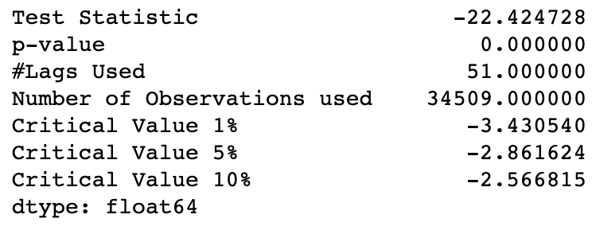
EDA - Trend
Rolling 1 week
(168 hours)
On the log transformed data
Rolling.mean( )
Rolling / moving average
On the log transformed data
Rolling.std( )
Rolling.mean( )
Adfuller

Slide 11
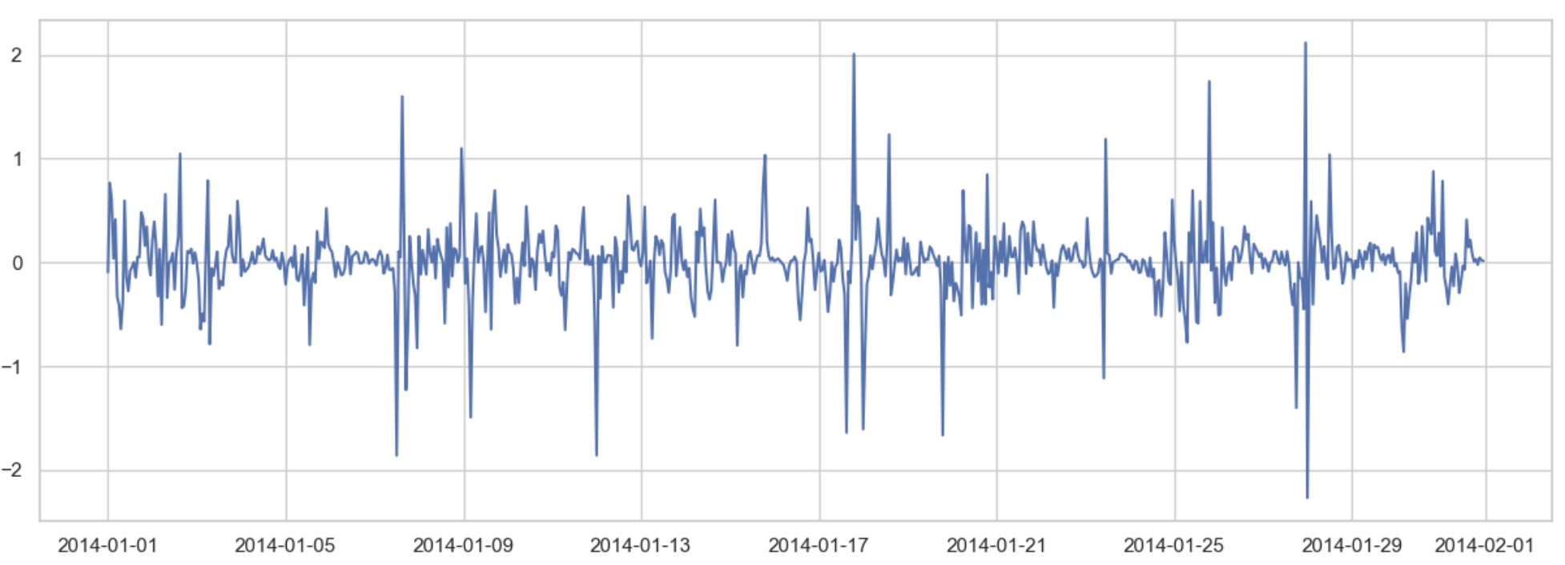
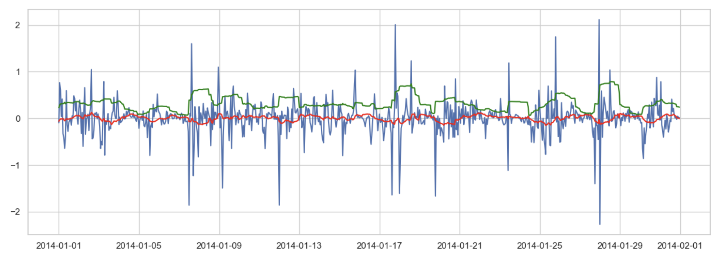
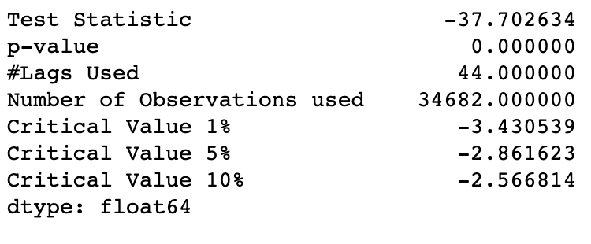
EDA - Seasonality
PM2.5_log_transformed - PM2.5_log_transformed.shift( )
Rolling(24).std( )
Adfuller
Rolling(24).mean( )

Slide 12
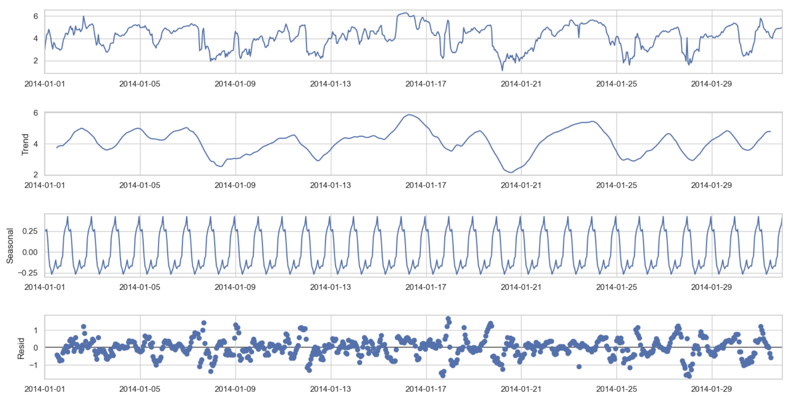
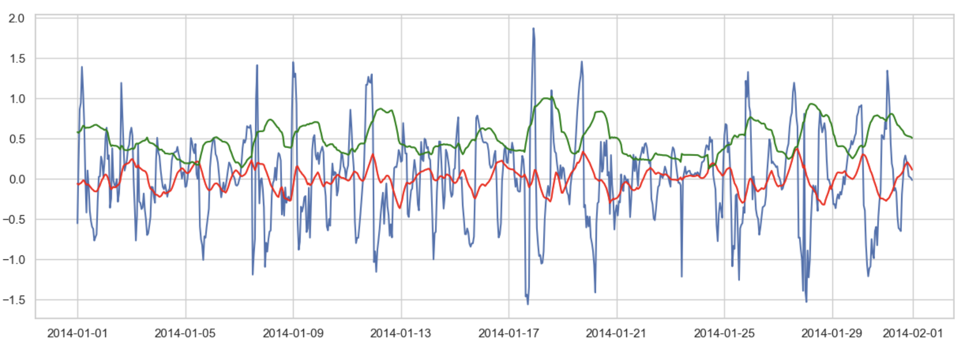
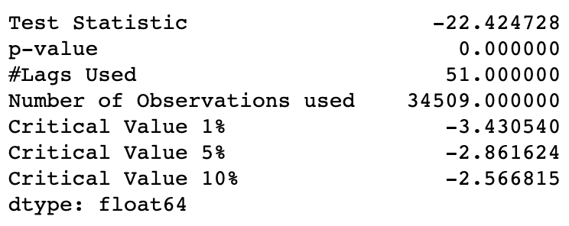
EDA - decomposition
Season period ~24h ( m=24 )
Adfuller
Decompose.resid
Rolling(24).std( )
Rolling(24).mean( )

Slide 13
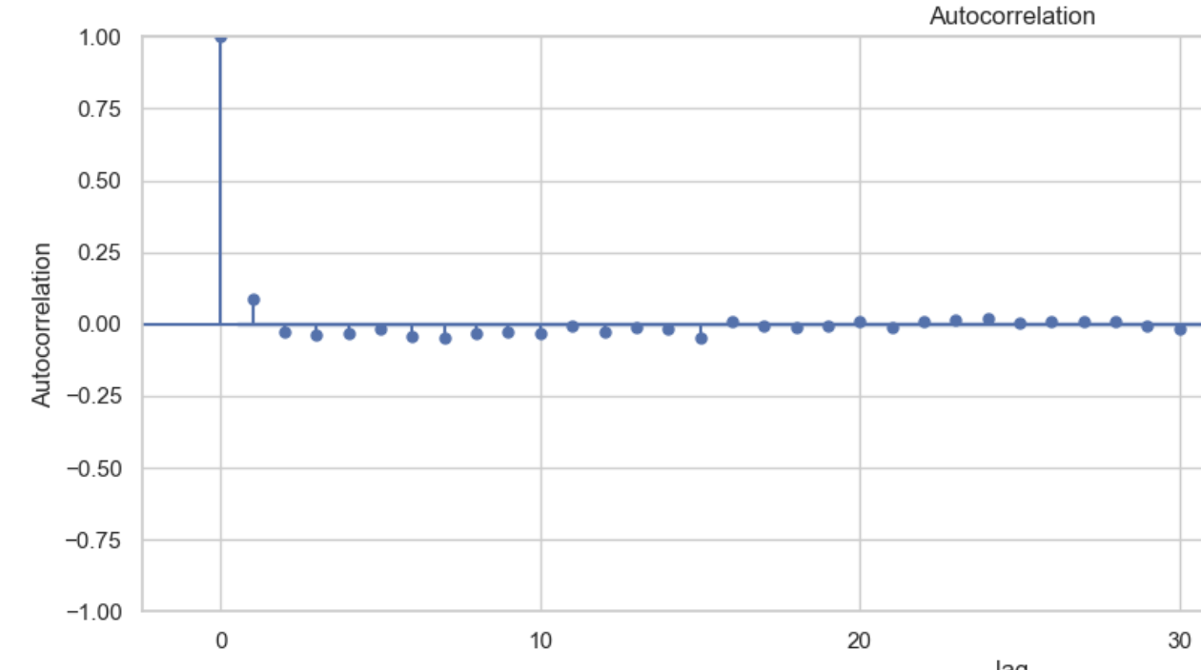
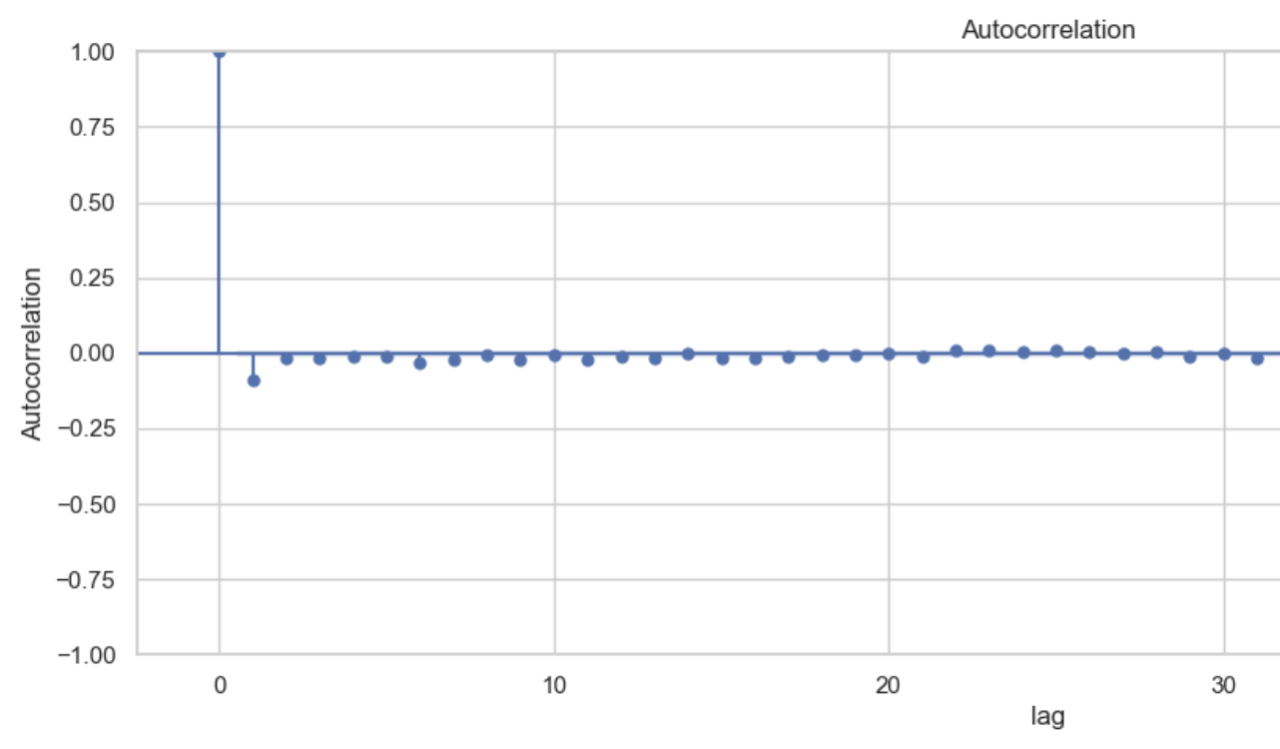
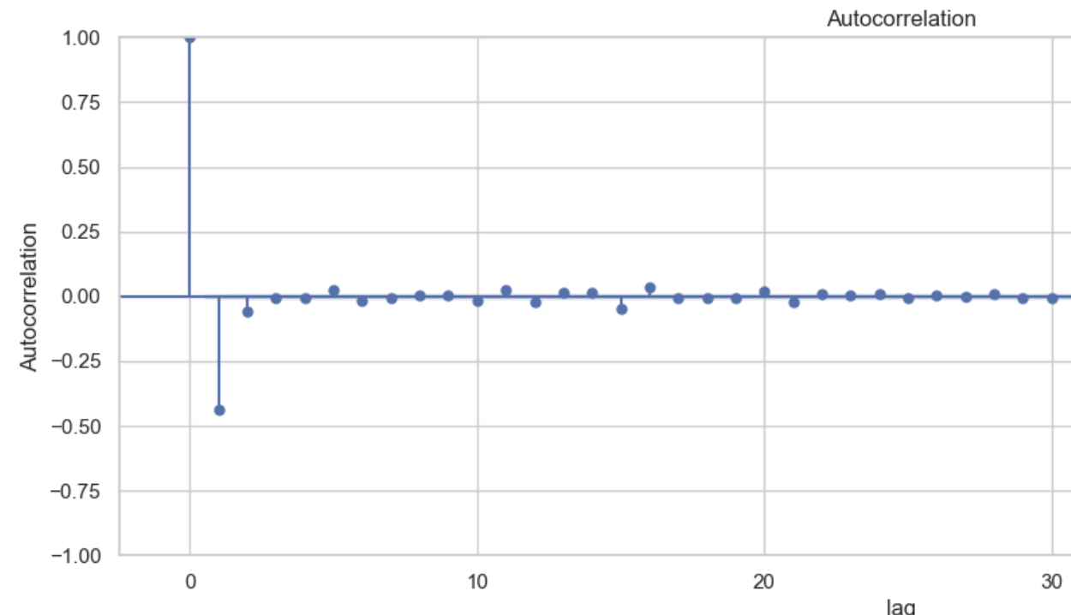
EDA - autocorrelation
acf.plot( ) – First order differencing
d = 1 with orginal data
log transformed data
d = 0 with log transformed data
acf.plot( ) – Second order differencing
over differencing

Slide 14
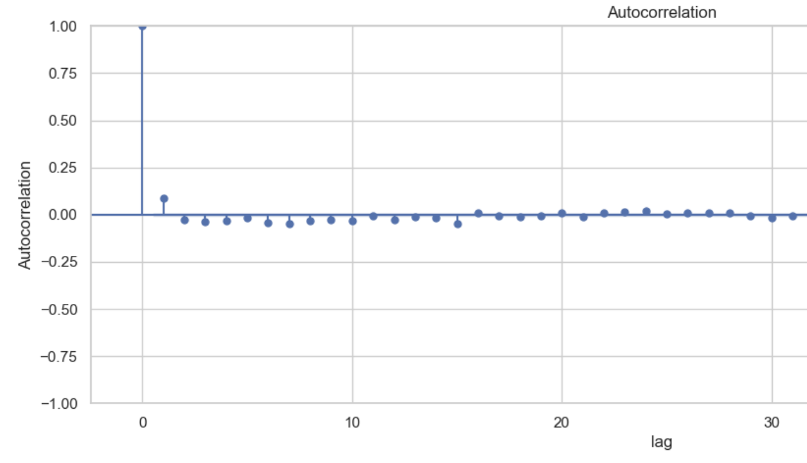
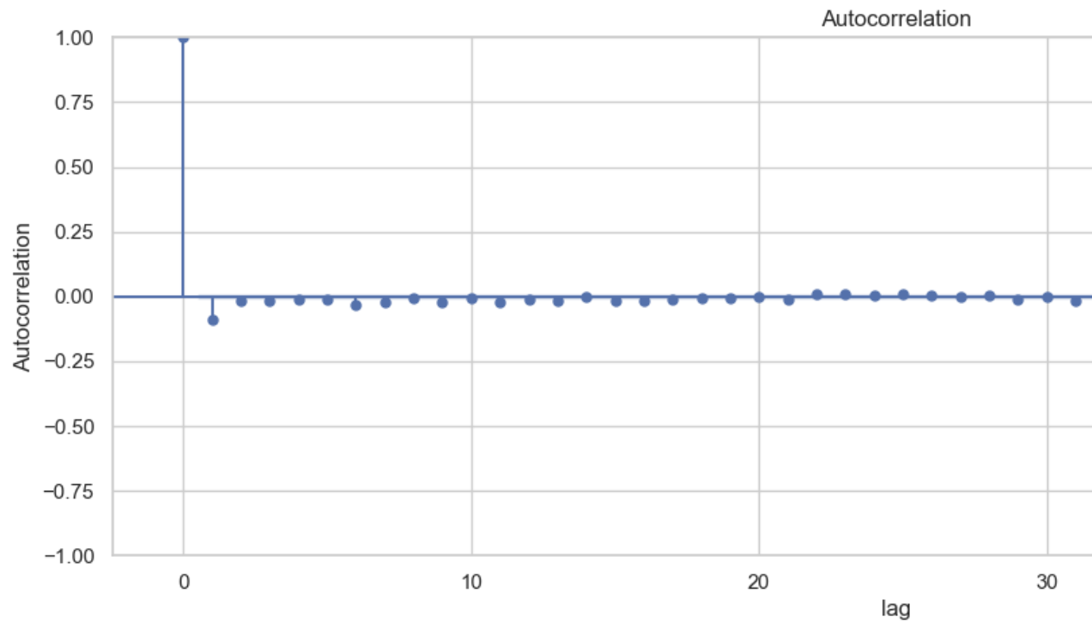
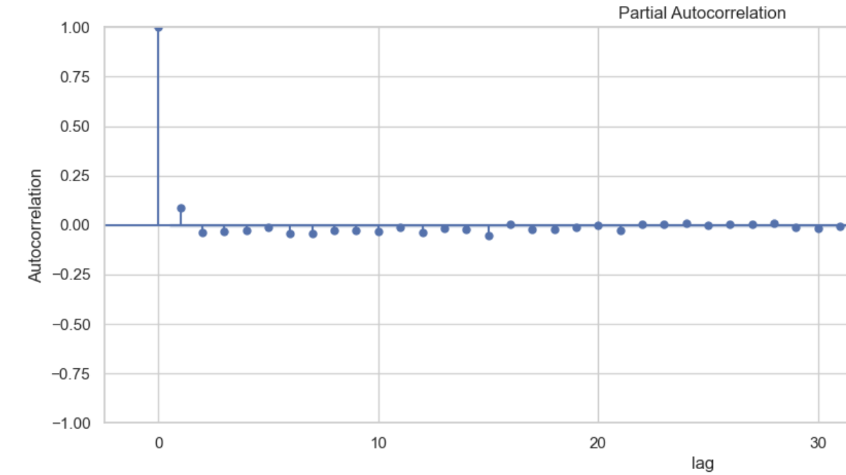
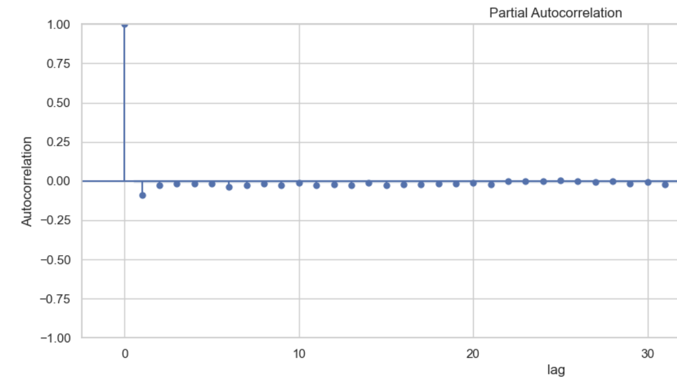
EDA – define p and q parameters (arima)
With the log transformed data
acf.plot( ) → q = 1
With the original data
pacf.plot( ) → p = 1
q = 0 and p = 0

Slide 15
2.3 Model selection

Slide 16

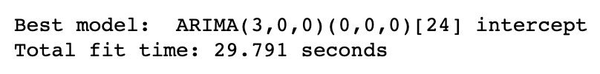
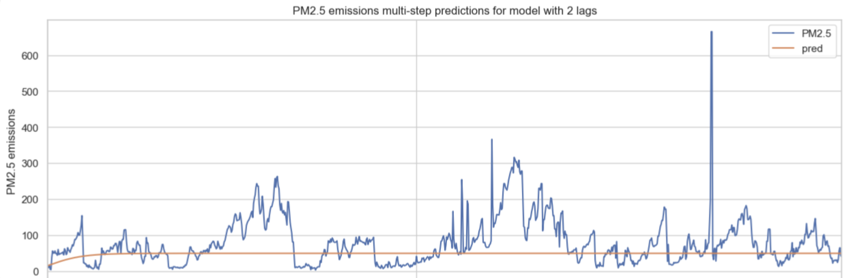
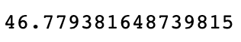
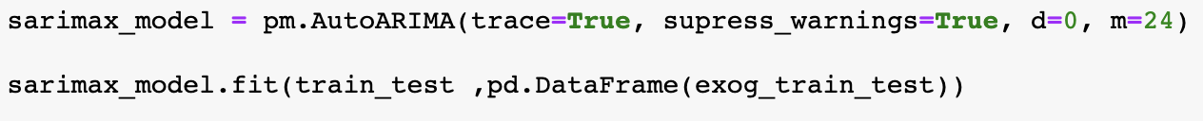
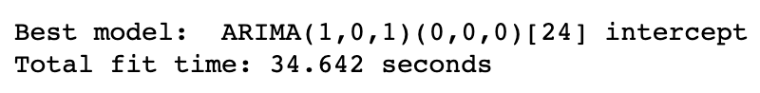
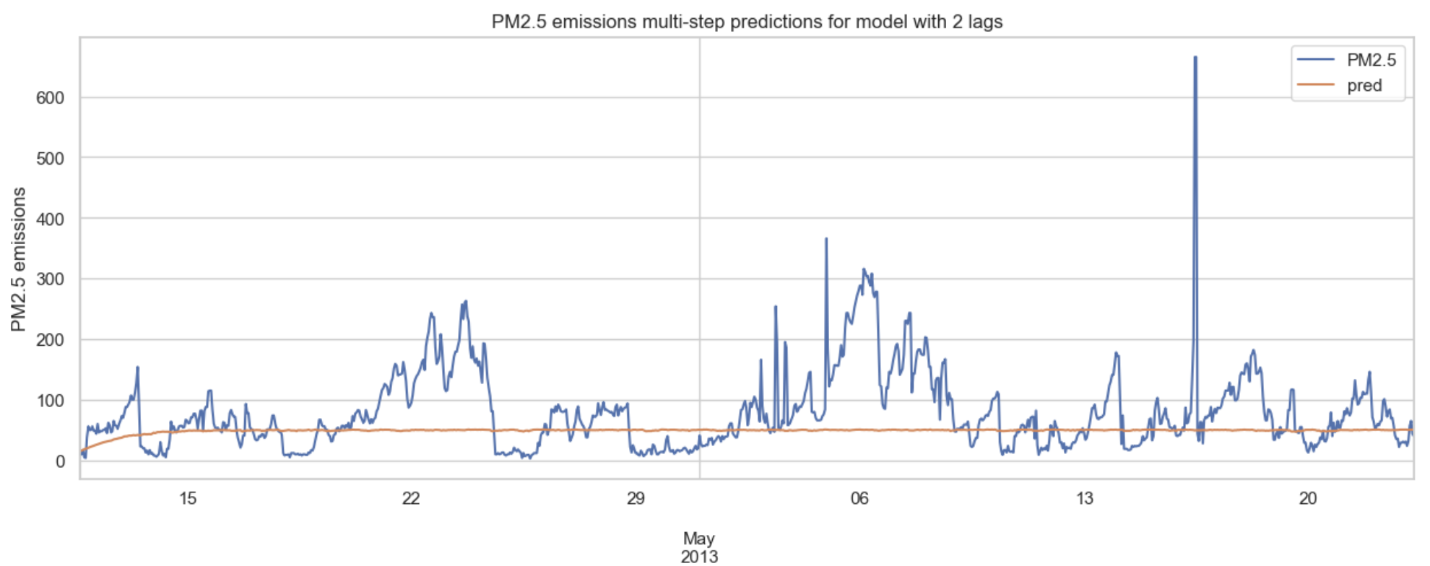
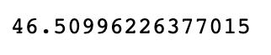
Sarima and Sarimax models
MAE =
MAE =

Slide 17
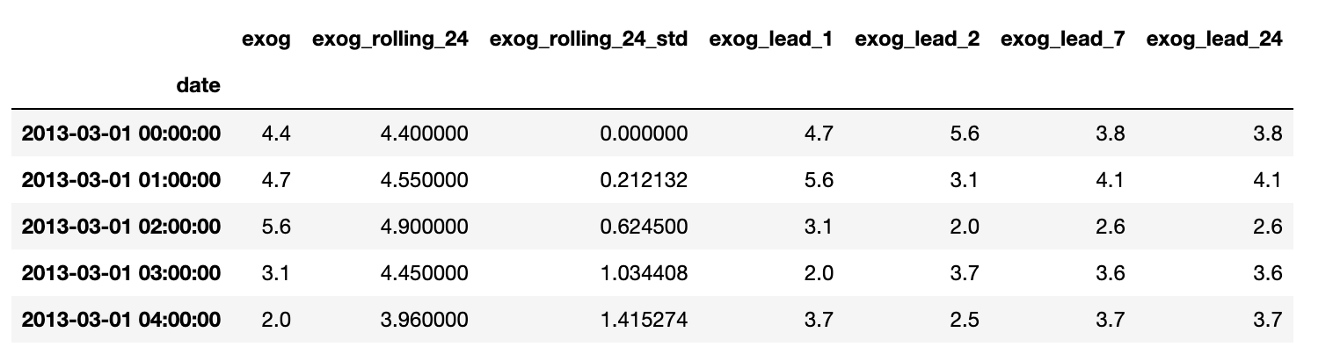

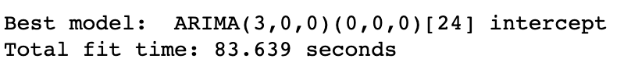
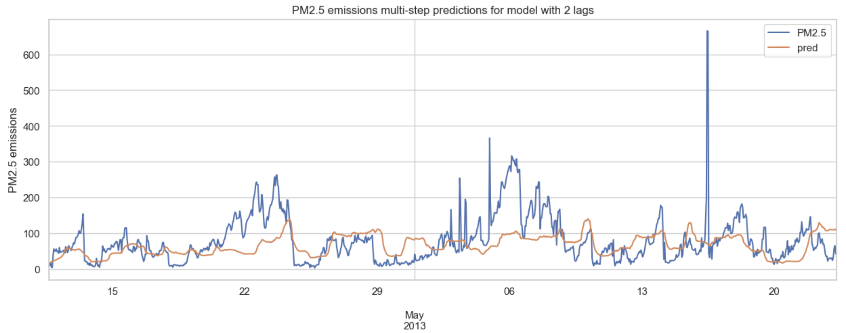
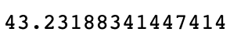
Sarimax + exog feature engineering
rolling_mean( min_periods =1)
dropna( ) for rolling_std
Missing values for exog_lead were filled with exog value
MAE =
Score on the portal ~75

Slide 18
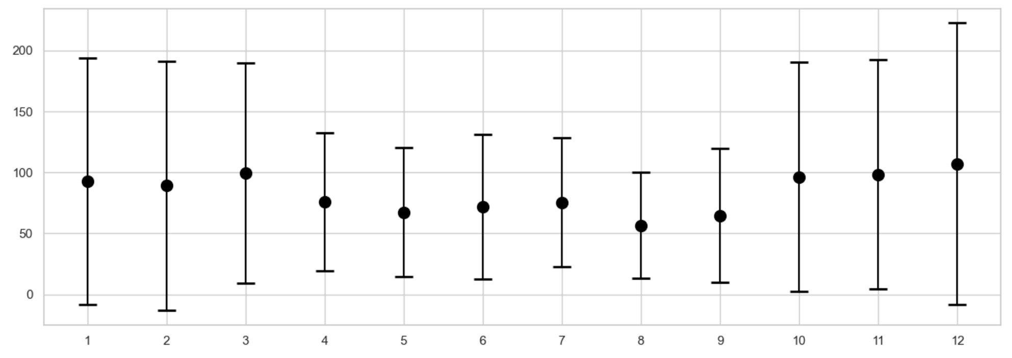
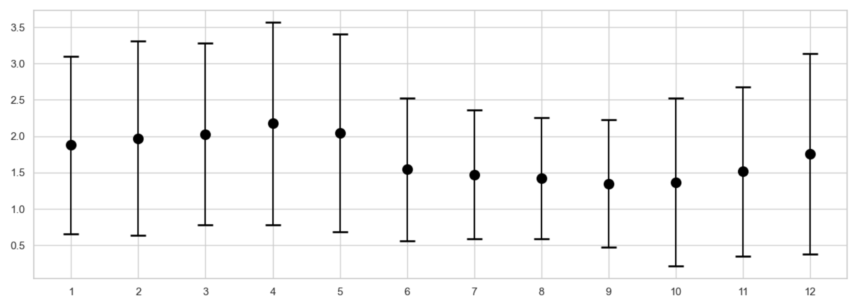
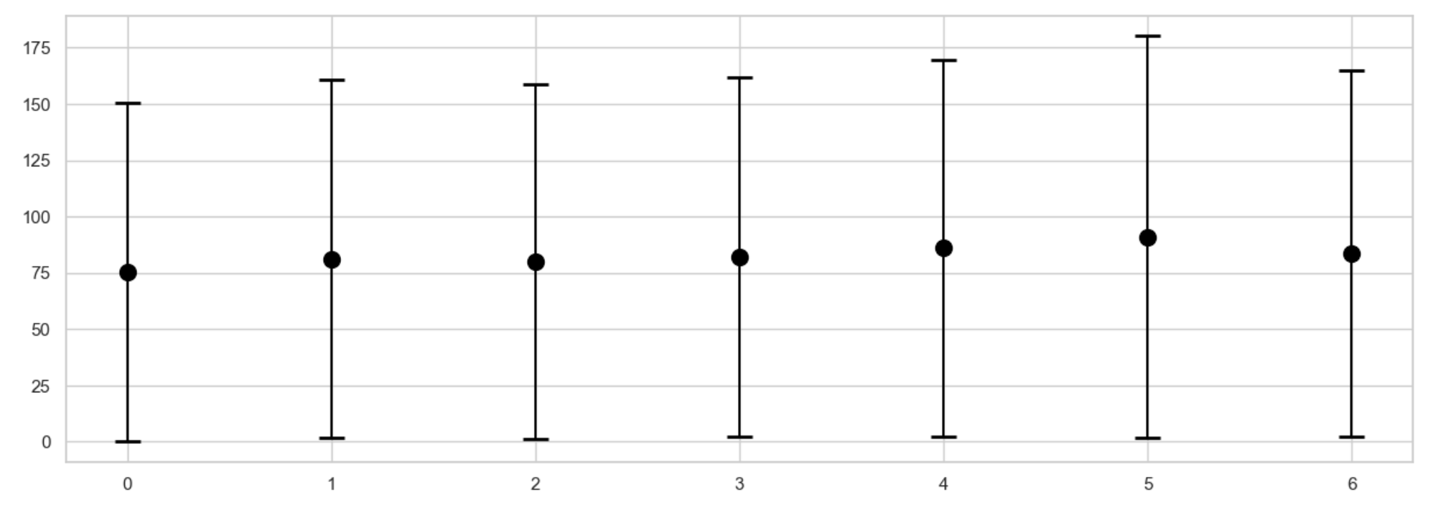
Regression model + features engineering
PM2.5 is changing during the month of the year
Wind speed forecast changes druing the year
PM2.5 is silghty higher during the weekends

Slide 19
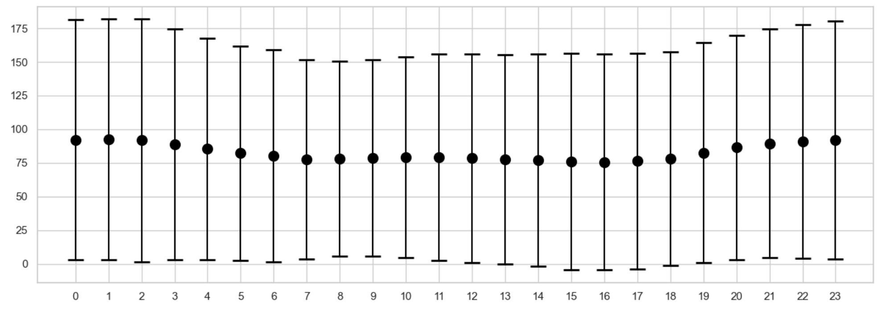
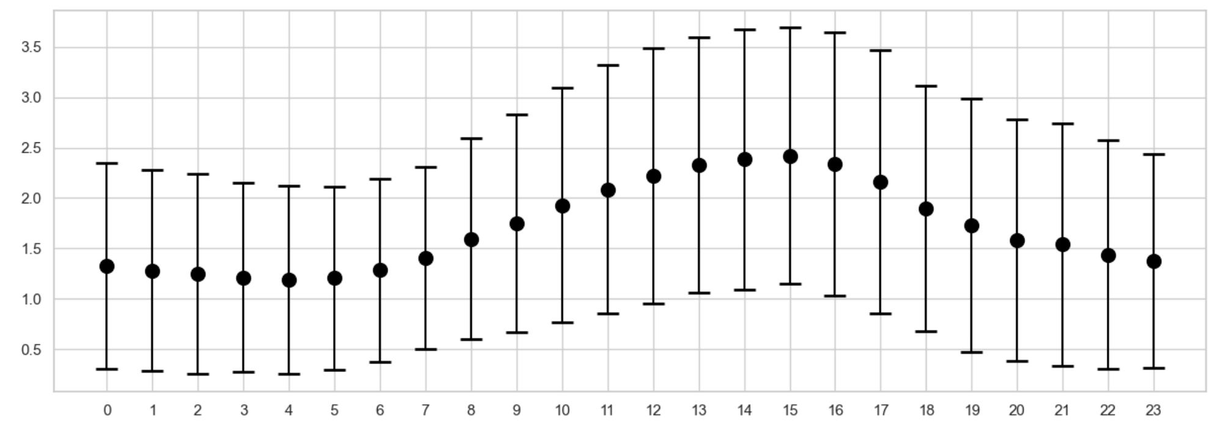
Regression model + features engineering
PM2.5 is sligthy higher at night
Wind speed is higher during daytime

Slide 20
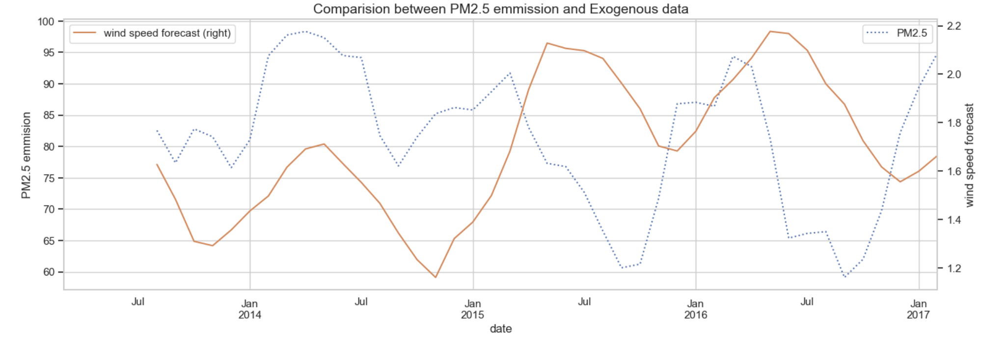
Regression model + features engineering
Rolling (6 hours)
Anti-correlation between PM2.5 pollution and wind speed forecast (except the first year )

Slide 21
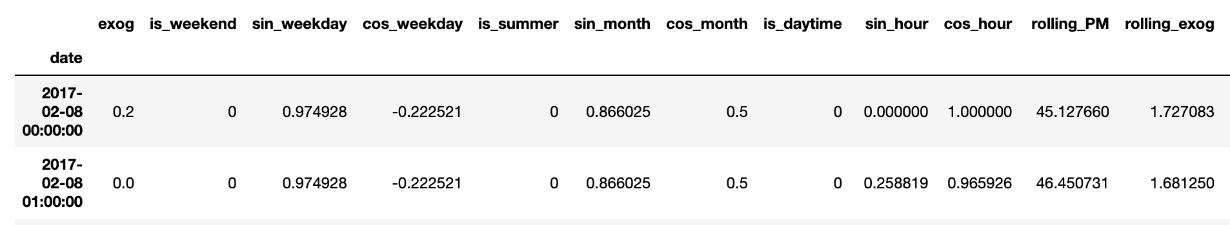
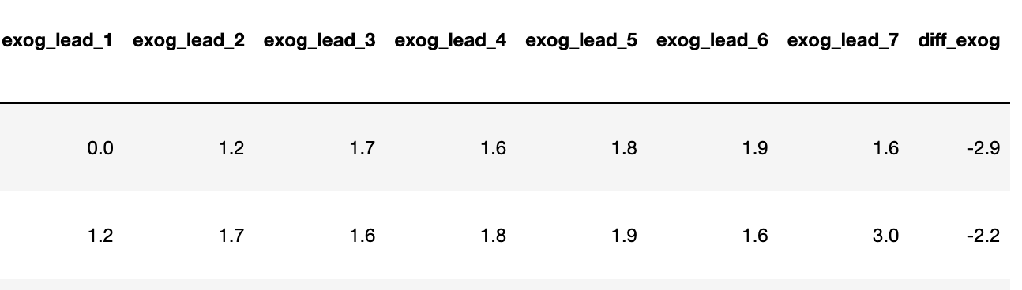
Regression model + features engineering
Rolling (48 hours)
diff (48 hours)
As there were no PM values in the test set (168 missing values)
I used for loop with linear Regression predict to feed the rolling PM in the test set

Slide 22
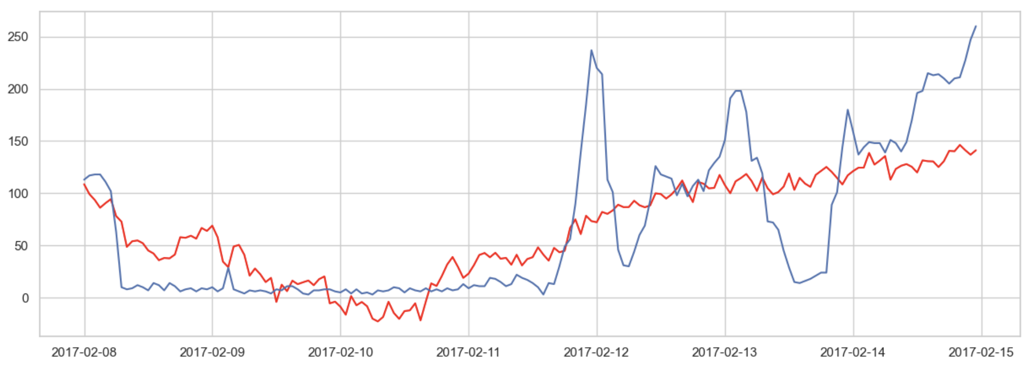
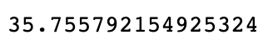
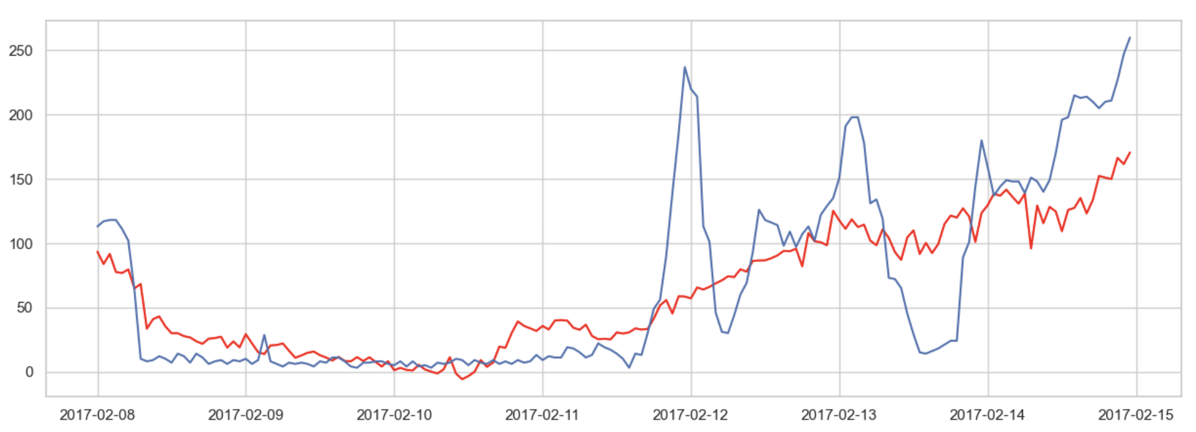
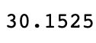
Regression model + features engineering
Linear Regression
Actual PM2.5
MAE =
PM2.5 predicted
Score on the portal ~ 54.997
Gradient Boosting Regressor (n_estimators =100)
MAE =
Score on the portal ~ 39.365

Slide 23
3. Future Work

Slide 24
Future work
To use different imputation technique for the missing values
(moving average imputation, interpolate (polynomial, spline) …)
To scale the dataset (minmaxscaler…)
To test different regression model (XGBoost, Random forest)
To understand why Sarima and Sarimax predicted poorly (I tried the refit method –> predict always the same values..)

Slide 25
The End!

Slide 26
Pun!

